Slide 1
DATA ANALYTICS • BUSINESS INTELLIGENCE REPORT
Chinook Digital Music Store
Customer, Sales & Catalog Analytics: Insights & Strategic Recommendations
Uttam Kumar Rout | July 2026

Slide 2
PROJECT OVERVIEW
Project Summary & Methodology
Chinook operates a global digital music storefront spanning 24 countries. This analysis mines the Chinook relational database (customers, invoices, tracks, albums, artists and genres) to answer 12 objective and 9 subjective business questions covering data quality, sales performance, customer behavior, churn, and revenue opportunity — translating raw transaction data into decisions management can act on.
DATABASE AT A GLANCE
59
Customers · 24 Countries
614
Invoices Analyzed
3,503
Tracks · 347 Albums
01
02
03
04
Data Quality Audit
Exploratory Analysis
Customer Analytics
Strategic Recommendations
275
Artists · 25 Genres
Checked nulls, duplicates & keys
Revenue, customers, catalog trends
Segmentation, churn, CLV, risk
Actionable, revenue-linked guidance
$4,709.43
Total Revenue Captured
CHINOOK DIGITAL MUSIC STORE | DATA ANALYTICS REPORT
2

Slide 3
Data Quality: Missing Values & Duplicates
Missing (NULL) Values by Field
Duplicate Records Check
✓
No duplicate primary keys found.
Invoice IDs are 100% unique across 614 invoices; the primary-key constraint holds.
✓
No duplicate customer records found.
Grouping by first name, last name & email returns zero customers with count > 1.
INSIGHT Structurally the data is clean (no duplicate keys/customers). Optional fields have expected gaps — 28% of tracks lack a composer credit and most consumer fields (Fax, Company, State) are sparsely populated, which is normal for an individual-consumer catalog rather than a data defect.
RECOMMENDATION No de-duplication is required. Standardize optional fields going forward: default missing State/Postal Code via address validation at checkout, and backfill Composer from label/rights-management metadata to unlock accurate songwriter royalty and rights reporting.
CHINOOK DIGITAL MUSIC STORE | DATA ANALYTICS REPORT
3

Slide 4
OBJ 02
Top-Selling Tracks, Artists & Genres — USA
Top 5 Artists by USA Revenue
USA Genre Revenue Mix
Top Track: “War Pigs” by Cake ($5.94) Most Famous Genre: Rock — accounts for over half of all USA sales revenue
INSIGHT Rock dominates the USA market at 53% of genre revenue, with classic/legacy rock artists (Van Halen, R.E.M., The Rolling Stones, Nirvana) driving the top revenue lines — demand is concentrated, not fragmented.
RECOMMENDATION Prioritize USA marketing spend, playlist placement, and rock catalog acquisition around these proven artists and the Rock/Alternative/Metal genre cluster (77% of USA revenue combined) before diversifying into long-tail genres.
CHINOOK DIGITAL MUSIC STORE | DATA ANALYTICS REPORT
4

Slide 5
Customer Demographics & Revenue by Geography
Customers by Country (Top 5)
Revenue by Country (Top 5)
Demographic scope note: Chinook stores only geographic fields (country/state/city) — no age or gender data exists, so customer demographics can only be profiled by location.
INSIGHT The USA leads on both customer count (13) and revenue ($1,040, 22% of total), but Canada, Brazil, France and Germany together already contribute over 1.6x the USA's revenue — Chinook's business is genuinely international, not USA-anchored.
RECOMMENDATION Treat the USA as the flagship market but resource Canada and Brazil as co-priority markets (highest revenue-per-customer efficiency outside the USA); localize catalog curation and payment options for these four secondary markets to defend share.
CHINOOK DIGITAL MUSIC STORE | DATA ANALYTICS REPORT
5

Slide 6
Top Customers & Individual Track Preferences
Top 5 Customers by Total Revenue (All Countries)
Customer | Country | Total Revenue
František Wichterlová | Czech Republic | $144.54
Helena Holý | Czech Republic | $128.70
Hugh O'Reilly | Ireland | $114.84
Manoj Pareek | India | $111.87
Luís Gonçalves | Brazil | $108.90
Customer A | Country | Total Revenue
METHOD NOTE
Revenue ranked with DENSE_RANK() partitioned by country — the full top-5-per-country leaderboard (all 24 countries) is available in the supporting workbook for account-management follow-up.
Top-selling track per customer is identified via ROW_NUMBER() over purchase quantity — giving a ready-made seed list for 1:1 recommendation emails.
INSIGHT The highest-value individual customers sit outside the USA (Czech Republic, Ireland, India, Brazil) — top spend is not concentrated in the largest market, and every customer's favorite track is now individually identifiable.
RECOMMENDATION Launch a VIP relationship program for the top-5-per-country customer list, and use each customer's top track as the seed for automated “more like this” recommendation emails to lift repeat purchase rate.
CHINOOK DIGITAL MUSIC STORE | DATA ANALYTICS REPORT
6

Slide 7
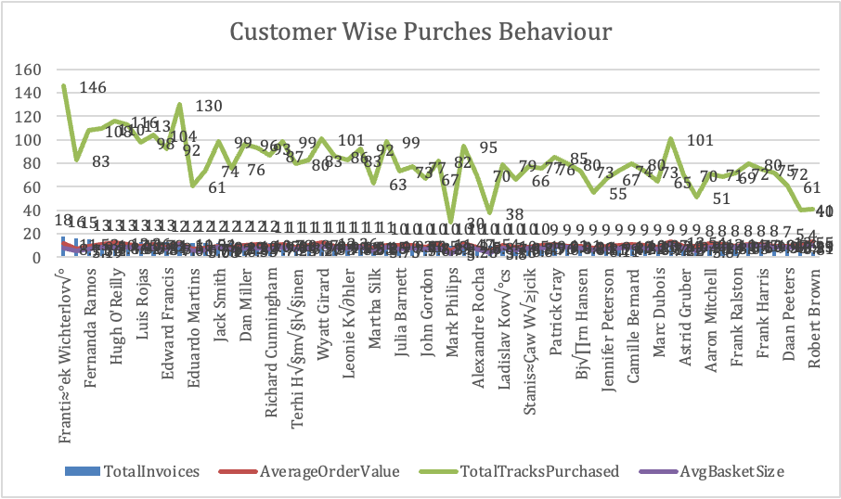
Customer Purchasing Behavior Analysis
Purchase Frequency | Average Order Value | Basket Size
10.4
$9.77
Avg. Invoices per Customer
Average Order Value
7.8
59
Avg. Tracks per Basket
Customers Profiled
INSIGHT
  • Customers have 4–18 invoices, indicating different engagement levels.
  • Average order value varies considerably by customer.
  • High track purchases (>100) indicate loyal, high-value customers.
  • Payment-method analysis is unavailable because the database has no payment-method field.
RECOMMENDATION
  • Launch loyalty programmes for frequent buyers.
  • Re-engage low-frequency customers with targeted offers.
  • Use cross-selling recommendations to increase basket size.
  • Monitor AOV, basket size and purchase frequency monthly.
Conclusion: Purchase frequency, Average Order Value and Basket Size are key indicators of customer loyalty and future revenue growth.
7

Slide 8
OBJ 08-12
Customer Churn Rate — Year-on-Year Trend
Churn Rate by Sales Year
Underlying Customer Counts
Year | Total Cust. | Churned | Churn %
2017 | 57 | 30 | 52.63%
2018 | 55 | 31 | 56.36%
2019 | 54 | 30 | 55.56%
2020 | 58 | 21 | 36.21%
Year | Total Cust. | Churned | Churn %
Methodology: a customer is “churned” in a sales year if their last purchase in that year trails the year's latest invoice date by more than 3 months.
INSIGHT Churn held stubbornly above 52% for three straight years (2017–19) before dropping to 36.21% in 2020 — a real improvement, but one to verify: 2020 is the final year in the dataset, so customers who buy late in the year haven't had a full 3-month window to be flagged as churned yet, which can artificially deflate the most recent year's rate.
RECOMMENDATION Treat 2017–19's ~55% average as the true baseline risk and prioritize the win-back program regardless of the 2020 figure; re-run this year-wise churn query once more months of 2020+ data land to confirm whether the improvement is genuine or a reporting-window artifact, and monitor churn quarterly rather than as a single point-in-time number.
CHINOOK DIGITAL MUSIC STORE | DATA ANALYTICS REPORT
8

Slide 9
OBJECTIVE Q9 & Q11
OBJ 09-11
Genre Sales Contribution & Ranking — USA
Rank | Genre | USA Revenue | % of USA Sales
1 | Rock | $555.39 | 53.4%
2 | Alternative & Punk | $128.70 | 12.4%
3 | Metal | $122.76 | 11.8%
4 | R&B/Soul | $52.47 | 5.0%
5 | Blues | $35.64 | 3.4%
Rank | Genre | USA Revenue | % of USA Sales
GENRE DIVERSITY
100%
of Chinook's 59 customers have purchased tracks from 3 or more distinct genres — every single customer is a genre-diverse, cross-sell-ready buyer.
INSIGHT Rock, Alternative & Punk and Metal together generate over 77% of USA revenue, yet every customer already buys across 3+ genres — the audience is diverse in taste even though revenue is genre-concentrated.
RECOMMENDATION Anchor USA promotional budget in the Rock/Alt/Metal cluster for guaranteed return, while using each customer's proven genre diversity to cross-sell adjacent genres (e.g., Blues, R&B) via personalized playlists rather than one-size-fits-all campaigns.
CHINOOK DIGITAL MUSIC STORE | DATA ANALYTICS REPORT
9

Slide 10
SUBJ 01-02
Album Advertising Priorities & Global Genre Trends
Top 3 Albums to Prioritize — USA
Top Genre Outside the USA, by Country
Are You Experienced?
$27.72
1
Jimi Hendrix
From The Muddy Banks Of The Wishkah [Live]
$27.72
2
Nirvana
The Doors
$26.73
3
The Doors
Rock ranks #1 in every one of the 23 non-USA countries analyzed — identical to the USA.
INSIGHT Rock's dominance is universal, not USA-specific — every market shows the same #1 genre, meaning global catalog strategy can be centralized rather than country-customized.
RECOMMENDATION Prioritize the three named albums for a global (not just USA) advertising push; run one worldwide Rock-focused campaign rather than fragmenting budget into per-country genre strategies, reserving country-level customization for secondary genres only.
CHINOOK DIGITAL MUSIC STORE | DATA ANALYTICS REPORT
10

Slide 11
SUBJ 03-05
Customer Loyalty, Product Affinity & Regional Patterns
Tenure Cohorts: Early Adopters vs. Later Joiners
PRODUCT AFFINITY
Hendrix & Nirvana tracks are the most frequently co-purchased pairs (e.g. “Foxy Lady” + “Third Stone From The Sun”, bought together 9 times) — driven by whole-album purchase behavior.
REGIONAL MARKET PATTERN
Average invoice value is remarkably stable across top markets ($7.01–$8.16), while total revenue is driven by customer count, not local spending power — suggesting acquisition, not pricing, is the main regional lever.
(Spend shown ÷10 to share an axis with invoice count: Early adopters avg $83.16 vs $74.20 for later joiners)
INSIGHT Early adopters spend ~12% more per year and buy more often, and purchases cluster by whole album rather than single tracks; average order value barely varies by country, so revenue growth is an acquisition problem, not a pricing or regional-behavior problem.
RECOMMENDATION Build a loyalty tier that rewards tenure (bonus content or early access) to protect the highest-value early-adopter cohort; add “complete the album” and “customers also bought” prompts at checkout; and focus regional growth investment on new customer acquisition rather than local price/catalog tuning.
CHINOOK DIGITAL MUSIC STORE | DATA ANALYTICS REPORT
11

Slide 12
Customer Risk Profiling & Lifetime Value
Customer Lifetime Value Segments
RISK PROFILE (No age/gender data available)
Recency of last purchase is the strongest available churn signal — 22 customers already exceed the 3-month inactivity threshold.
High lifetime spend does not guarantee retention: several high-CLV customers are also among the longest-inactive — these are the highest-priority win-back targets.
Because 95% of customers already qualify as “High Value,” spend alone is a poor risk filter — recency and frequency matter more here than absolute spend.
No customers fall below $20 lifetime spend — the base is small (59) but consistently engaged.
INSIGHT CLV is high and fairly uniform across the base, so the real differentiator of future value is behavioral (recency, frequency) rather than demographic (unavailable) or spend-tier — and the highest financial risk sits with high-spend customers who have gone quiet.
RECOMMENDATION Build a two-factor risk score (recency × historical spend) instead of spend-tier alone; route high-CLV + high-inactivity customers into a white-glove win-back outreach before generic churn campaigns, since losing them carries outsized revenue impact.
CHINOOK DIGITAL MUSIC STORE | DATA ANALYTICS REPORT
12

Slide 13
CONCLUSION
Key Recommendations for Management
1
Fix churn first
37% churn rate is the top financial risk — launch a 60-day inactivity win-back journey, prioritizing high-CLV inactive customers.
2
Concentrate, don't scatter, marketing
Rock/Alternative/Metal drive 77%+ of revenue in every market — fund one global campaign around the top 3 albums and artists instead of per-country plans.
3
Grow through acquisition, not price
Order values are stable across countries — revenue growth in secondary markets (Canada, Brazil, France, Germany) should come from new customers, not pricing changes.
4
Personalize, don't generalize, retention
Every customer already buys 3+ genres and has an identifiable top track — use this for automated cross-sell and “complete the album” prompts at checkout.
5
Close two data gaps
Add payment_method to Invoice and complete Composer metadata — both block deeper checkout and rights-management analytics.
The Chinook database, though modest in scale, is clean and rich enough to support real decisions today: a churn-reduction program, a focused catalog marketing push, and two schema additions will meaningfully improve both revenue retention and future analytical depth.

